Slide 1
Data Structure (01AI0304) Unit 1 Introduction
Hitesh Kag

Slide 2
Syllabus
1 | Introduction: Introduction to data type and data structure. Types of data structure: primitive & non-primitive, linear & non-linear. Operations on data structures: traversing, searching, inserting, deleting e.t.c. Algorithms, Complexity analysis – worst case, best case, average case.
2 | Arrays: Introduction to Arrays, Array Representation: Row major order & Column major order, One dimensional and 2D array, Storage structure of arrays, operations on arrays, Sparse Matrix
3 | Sorting and Searching: Introduction, Classification of Sorting, Types: Bubble sort, Selection sort, Insertion sort, Quick Sort, Merge Sort, Radix sort. Searching: Linear or sequential search, Binary search

Slide 3
Syllabus
4 | Stack, Queue and Linked List: Introduction to Stack and implementation, Operations on stacks, Polish Expressions and their compilation, Application of stack: Tower of Hanoi, Recursion. Queue: Introduction to Queue and implementation, operations on Queue (insert, delete), Circular Queue, Double Ended Queue, Priority Queues, Applications of Queue. Linked List: Introduction, Implementation of Linked List, Singly Linked List, Doubly Linked List, Circular Linked List, Circular Doubly Linked, and Applications of Linked List.
5 | Tree and Graphs: Tree: Terminologies, Types of tree, Binary Tree Traversal Techniques (Inorder, preorder, postorder). Binary Search Tree: Definition, Operations, AVL Tree: Definition, Insertion, Deletion, Rotations. Special trees: construction of B Tree and B+ Tree Graph: Terminologies, Representation of graphs Types of Graph, Graph Traversal Techniques: BFS & DFS, Application of Trees and Graphs
6 | Hashing: Concepts and Hash Function, Hashing Methods, Collision, Collision Resolution Technique (CRT), Perfect Hashing

Slide 4
Evaluation
CSE-20 marks
IA-30 marks
ESE-50 marks
Viva-25 marks
TW-25 marks

Slide 5
Introduction
Data Structure is a way to store and organize data so that it can be used efficiently.
It is a way of arranging data on a computer so that it can be accessed and updated efficiently.
The study of data structure allows us to understand the organization of data and the management of the data flow in order to increase the efficiency of any process or program.

Slide 6
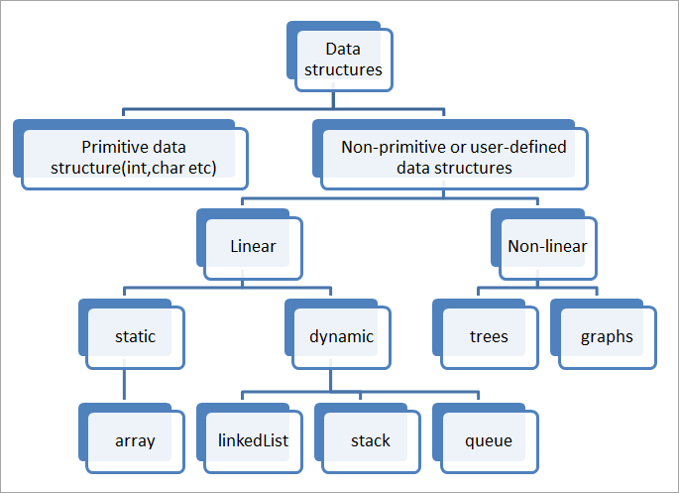
Classification of Data Structure

Slide 7
Primitive Data Structures
Primitive Data Structures are the data structures consisting of the numbers and the characters that come in-built into programs.
These data structures can be manipulated or operated directly by machine-level instructions.
Basic data types like Integer, Float, Character, and Boolean come under the Primitive Data Structures.

Slide 8
Non- Primitive DS
Non-Primitive Data Structures are those data structures derived from Primitive Data Structures.
These data structures can't be manipulated or operated directly by machine-level instructions.
The focus of these data structures is on forming a set of data elements that is either homogeneous (same data type) or heterogeneous (different data types).
Based on the structure and arrangement of data, we can divide these data structures into two sub-categories -
Linear Data Structures
Non-Linear Data Structures
Linear data structure: Data structure in which data elements are arranged sequentially or linearly, where each element is attached to its previous and next adjacent elements, is called a linear data structure. Examples of linear data structures are array, stack, queue, linked list, etc.

Slide 9
Non-linear data structure
Non-linear data structure: Data structures where data elements are not placed sequentially or linearly are called non-linear data structures.
In a non-linear data structure, we can’t traverse all the elements in a single run only. Examples of non-linear data structures are trees and graphs.

Slide 10
Static vs Dynamic DS
Static data structure: Static data structure has a fixed memory size. It is easier to access the elements in a static data structure. An example of this data structure is an array.
Dynamic data structure: In dynamic data structure, the size is not fixed.
It can be randomly updated during the runtime which may be considered efficient concerning the memory (space) complexity of the code. Examples of this data structure are queue, stack, Linked List.

Slide 11
Operations on DS
Insert
Delete
Traverse/Display/Print
Sort
Search
Manipulate/update/modify

Slide 12
Unit 2 Arrays

Slide 13
Array
An array is the collection of similar data items together in a contiguous memory location.
We can locate each element with the help of its index.
A data structure that stores a sequential collection of elements that are of a fixed size and the same type under a single name.
int a[] = {25, 50, 75, 100};
int a[]={1,2};
int a[5]={1,2};
int a[10];

Slide 14
Advantages
Accessing an element is very easy by using the index number.
The search process can be applied to an array easily.
2D Array is used to represent matrices.
Sorting is simple in array
Arrays can be easily converted to pointers, which allows for passing arrays to functions as arguments or returning arrays from functions.
Multiple Uses: Stacks, queues, graphs, trees, and other types of data structures can all be created using the basic data structure of arrays
Passing to Functions

Slide 15
Disadvantages
Size is fixed:
The problem in expansion
Memory wastage
Limitation of type of data
Insertion and Deletion is difficult

Slide 16
Finding the address in 1D array
Address of Array[i] = B + w*(i −L.B.)
i = index of an element to be searched.
B = Base address i.e. address of the first element of arrays/address of the array
w = size of the data type stored in an array
L.B. = lower bound(i.e. index of the first element of the Array), if a lower bound is not given consider it as 0.

Slide 17
Lab Program 1
Taking array as input/Displaying or printing the array
Element insertion at the beginning, at the ending and at the specific position
Deletion at beginning or any particular position

Slide 18
Inserting the element onto the array
1. Get the element value which needs to be inserted.
2. Get the position value.
3. Check whether the position value is valid or not.
4. If it is valid,
Shift all the elements from the last index to position index by 1 position to the right.
insert the new element in arr[position]
5. Otherwise,
Invalid Position

Slide 19
Deleting the element from the array
1. Set index value as -1 initially. i.e. index = -1
2. Get key value from the user which needs to be deleted.
3. Search and store the index of a given key
[index will be -1, if the given key is not present in the array]
4. if index not equal to -1
Shift all the elements from index + 1 by 1 position to the left.
5. else
print "Element Not Found"

Slide 20
2D Array
If we want to store data as a tabular form, like a table with rows and columns, we use multidimensional arrays.
int a[2][3] = { {1, 4, 2}, {3, 6, 8} };

Slide 21
Row Major Order representation
In the Row Major Order elements of an array are stored in a Row-Wise fashion.
Row major ordering assigns successive elements, moving across the rows and then down the next row, to successive memory locations.

Slide 22
Address of A[i][j] = B + W * ((i – LR) * N + (j– LC))
i = Row Subset of an element whose address to be found, j = Column Subset of an element whose address to be found, B = Base address, W = Storage size of one element store in an array(in byte), LR = Lower Limit of row/start row index of the matrix(If not given assume it as zero), LC = Lower Limit of column/start column index of the matrix(If not given assume it as zero), N = Number of column given in the matrix.
Que: Given an array, arr[0………10][0………15] with base value 100 and the size of each element is 2 Byte in memory. Find the address of arr[8][6] with the help of row-major order.

Slide 23
Column Major Order Representation
If elements of an array are stored in a column-major fashion means moving across the column and then to the next column then it’s in column-major order.
To find the address of the element using column-major order use the following formula:

Slide 24
Address of A[I][J] = B + W * ((I – LR) +N* (J – LC))
I = Row Subset of an element whose address to be found, J = Column Subset of an element whose address to be found, B = Base address, W = Storage size of one element store in any array(in byte), LR = Lower Limit of row/start row index of matrix(If not given assume it as zero), LC = Lower Limit of column/start column index of matrix(If not given assume it as zero), M = Number of rows given in the matrix.
Given an array arr[1………10][1………15] with a base value of 100 and the size of each element is 1 Byte in memory find the address of arr[8][6] with the help of column-major order.

Slide 25
Given the base address of an array A[1300 ………… 1900] as 1020 and the size of each element is 2 bytes in the memory, find the address of A[1700].

Slide 26
Given the base address of an array A[1300 ………… 1900] as 1020 and the size of each element is 2 bytes in the memory, find the address of A[1700] using row major order representation.

Slide 27
Sparse Matrix
If most of the elements of the matrix have 0 value, then it is called a sparse matrix.
Sparse Matrix Representations can be done in many ways following are two common representations:
Array representation
Linked list representation

Slide 28
Using Arrays
Representing a sparse matrix by a 2D array leads to the wastage of lots of memory.
This is because zeroes in the matrix are of no use, so storing zeroes with non-zero elements is wastage of memory.
To avoid such wastage, we can store only non-zero elements. If we store only non-zero elements, it reduces the traversal time and the storage space
Row: Index of row, where non-zero element is located
Column: Index of column, where non-zero element is located
Value: Value of the non zero element located at index – (row,column)

Slide 29
Using Linked List
In linked list, each node has four fields. These four fields are defined as:
Row: Index of row, where non-zero element is located
Column: Index of column, where non-zero element is located
Value: Value of the non zero element located at index – (row,column)
Next node: Address of the next node

